Slide 1
Infrastructure Automation with Terraform & Azure Devops on Azure cloud
Harshal Mittal

Slide 2
What is DevOps? Section 8
Notes:
In this section we will start with DevOps and what is Microsoft offering as Devops service?

Slide 3
DevOps
Practices that combines software development (dev) and IT operations (ops).
Shorten the systems development life cycle and provide continuous delivery with high software quality.
Real-time feedback loop concept.
Further extends it to other key areas in the software development lifecycle.
Reduce risks due to potential disconnects between developers, operations staff and quality assurance.
Notes:
Devops is a set of Practices that combines software development (dev) and IT operations (ops).
It aims is to Shorten the systems development life cycle and provide continuous delivery with high software quality.
It uses the Real-time feedback loop concept.
It Further extends to other key areas in the software development lifecycle.
It Reduces risks due to potential disconnects between developers, operations staff and quality assurance.

Slide 4
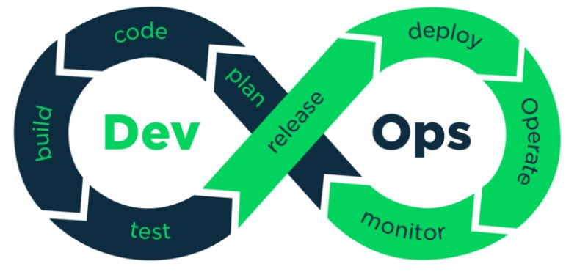
DevOps
Notes:
DevOps uses the real-time feedback loop concept and further extends it to other key areas in the software development lifecycle.
In order to remove any potential disconnect between development and sustainment, DevOps practitioners include IT Operations Professionals within the development team from the beginning.
DevOps utilises the principles of Agile methodologies and expands their scope, understanding that ensuring high-quality development, requires continual engagement, feedback and integration from a range of technical professionals; developers, quality assurance and operations specialists, ensuring better collaboration and tighter integration.

Slide 5
Benefits of adopting DevOps
Collaboration culture, identifying and eradicating the barriers.
Quicker and smarter, together automation, continuous integration and a standardised set of tools and processes.
Open communication and transparency strong communication.
React quicker with recognised processes, clear priorities, more visibility and proactive retrospection, dev and ops teams have strong platforms and foundations to react and better manage unplanned work.
Accelerating time to market.
Adapting to the market and competition.
Maintaining system stability and reliability.
Improving the mean time to recovery.
Notes:
Benefits of adopting DevOps.
Culture and collaboration Culture is the number 1 success factor in DevOps. DevOps is that refreshing change in looking at the development process, identifying and eradicating the barriers between development and operations.
Quicker and smarter, together automation, continuous integration and a standardised set of tools and processes, teams will become more efficient and release more frequently with fewer disruptions.
Open communication and transparency Strong communication coupled with complete transparency is required for DevOps teams to reduce downtime and resolve issues as quickly as possible. Open communication and transparency enables Dev and Ops teams to identify issues, fix incidents and remove obstacles, helping to release quicker.
React quicker with recognised processes, clear priorities, more visibility and proactive retrospection, Dev and Ops teams have strong platforms and foundations to react and better manage unplanned work, whilst working on the planned work simultaneously.
Accelerating time to market
Adapting to the market and competition
Maintaining system stability and reliability
Improving the mean time to recovery

Slide 6
Azure DevOps
SAAS from Microsoft, many services are either free for small team or available through a subscription model or per-user model
Sign with a Microsoft or a GitHub account www.Dev.Azure.Com
Scalable, reliable, and globally available hosted service. It's backed by a 99.9% SLA, monitored 24/7 by operations team, and available around the world.
Integrated set of services and tools for software projects.
Through client-server model, easy to use web interface.
Free unlimited private git repo.
Create organization, projects and invite your teammates.
Connect to your development tool like eclipse, XCode, visual studio or android studio to work on apps anytime, anywhere.
Notes:
Azure devops is saas from Microsoft. Many services are either free for small teams or available through a subscription model or per-use model.
You can sign in to azure devops with a Microsoft or GitHub account, the url for azure devops is dev.azure.com
It is scalable, reliable, and globally available hosted service. It's backed by a 99.9% SLA, monitored 24/7 by Microsoft operations team, and it is available around the world.
With Azure DevOps, you gain an integrated set of services and tools to manage your software projects, from planning and development through testing and deployment.
Services are delivered through a client/server model. Many of them are delivered through an easy-to-use web interface that you can access from all major browsers.
Some services, such as source control, build pipelines, and work tracking, can also be managed through a client.
You can start by creating an organization, create a project in that orgranisation, and invite your teammates to work on your projects.
It let you connect to your favourite development tool like Eclipse, Xcode, Visual Studio or Android Studio to work on apps anytime, anywhere.

Slide 7
Demo
Notes:
Let me show you Azure devops service and how I can create an organisation and a project in that organisation.

Slide 8
Azure Boards, Repos and Pipelines
Next video
Notes:
In the next video, We will learn some azure devops tools like Azure Boards, Repos and Pipelines.

